Slide 1

Basic Solutions Concepts (pt 5)
Chris Kiekintveld

Slide 2
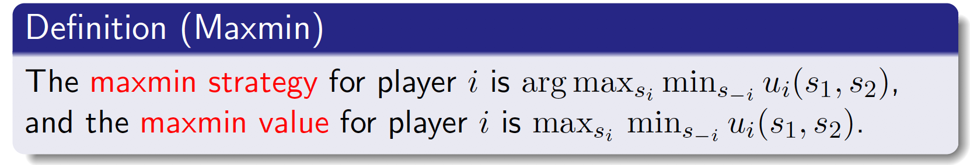
Maxmin Strategies
Player i's maxmin strategy is a strategy that maximizes i’s worst-case payoff, in the situation where all the other players (denoted -i) play the strategies which cause the greatest harm to i.
The maxmin value (or safety level) of the game for player i is that minimum amount of payoff guaranteed by a maxmin strategy.
Why would player i want to play a maxmin strategy?

Slide 3
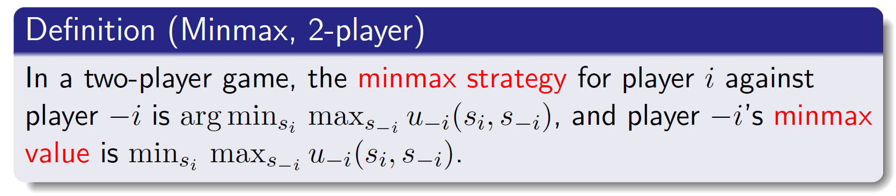
Minmax Strategies
Player i's minmax strategy against player -i in a 2-player game is a strategy that minimizes -i's best-case payoff, and the minmax value for i against -i is payoff
Why would i want to play a minmax strategy?
to punish other agents as much as possible

Slide 4
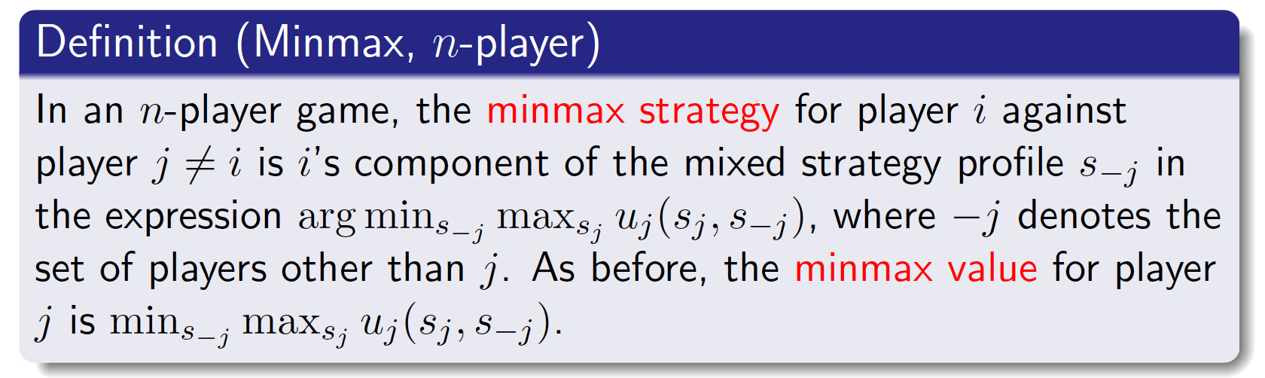
Minmax Strategies
Player i's minmax strategy against player -i in a 2-player game is a strategy that minimizes -i's best-case payoff, and the minmax value for i against -i is payoff
Why would i want to play a minmax strategy?
to punish other agents as much as possible
We can generalize to n players

Slide 5
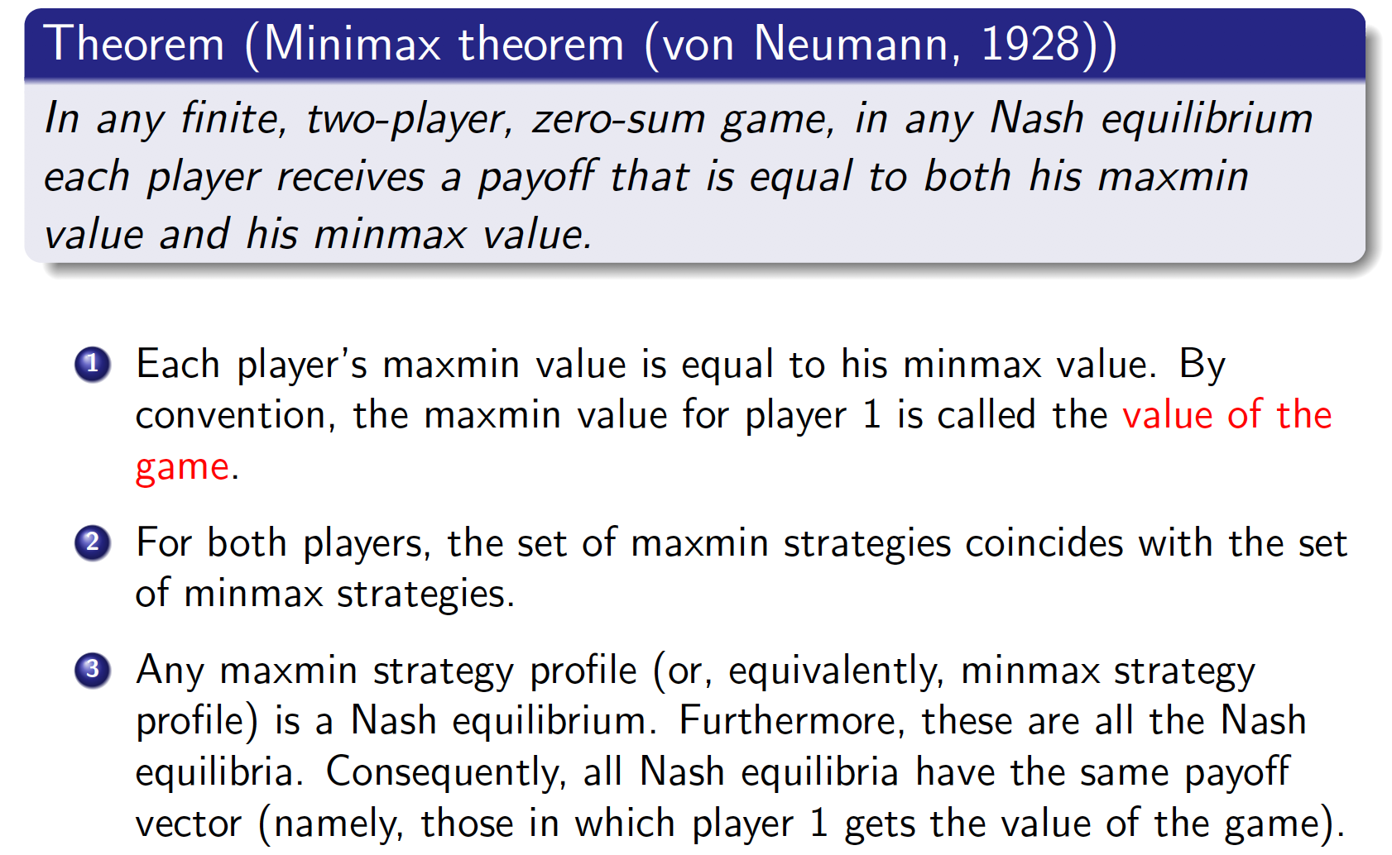
Minmax Theorem

Slide 6
Regret in Games
The concept of regret generalizes from decision theory to game theory
General idea is always:
Value received – Value of best action given outcome

Slide 7
Regret Tables
 | L | C | R
U | 3, 5 | 5, 3 | 4, 2
M | 1, 3 | 1, 6 | 3, 5
D | 4, 2 | 2, 2 | 1, 3
Payoff Table
 | L | C | R
U | 1, 0 | 0, 2 | 0, 3
M | 3, 3 | 4, 0 | 1, 1
D | 0, 1 | 3, 1 | 3, 0
Regret Table

Slide 8
Regret Minimization
We can replace standard best-response (or maxmin) concepts with regret minimization
Min max regret
Min expected regret
Regret minimization is also used as a learning algorithm (and solution algorithm)
Nash Equilibrium profiles have zero regret

